Slide 1
MICCAI Career Advancement
Antonio R. Porras, PhD

Slide 2


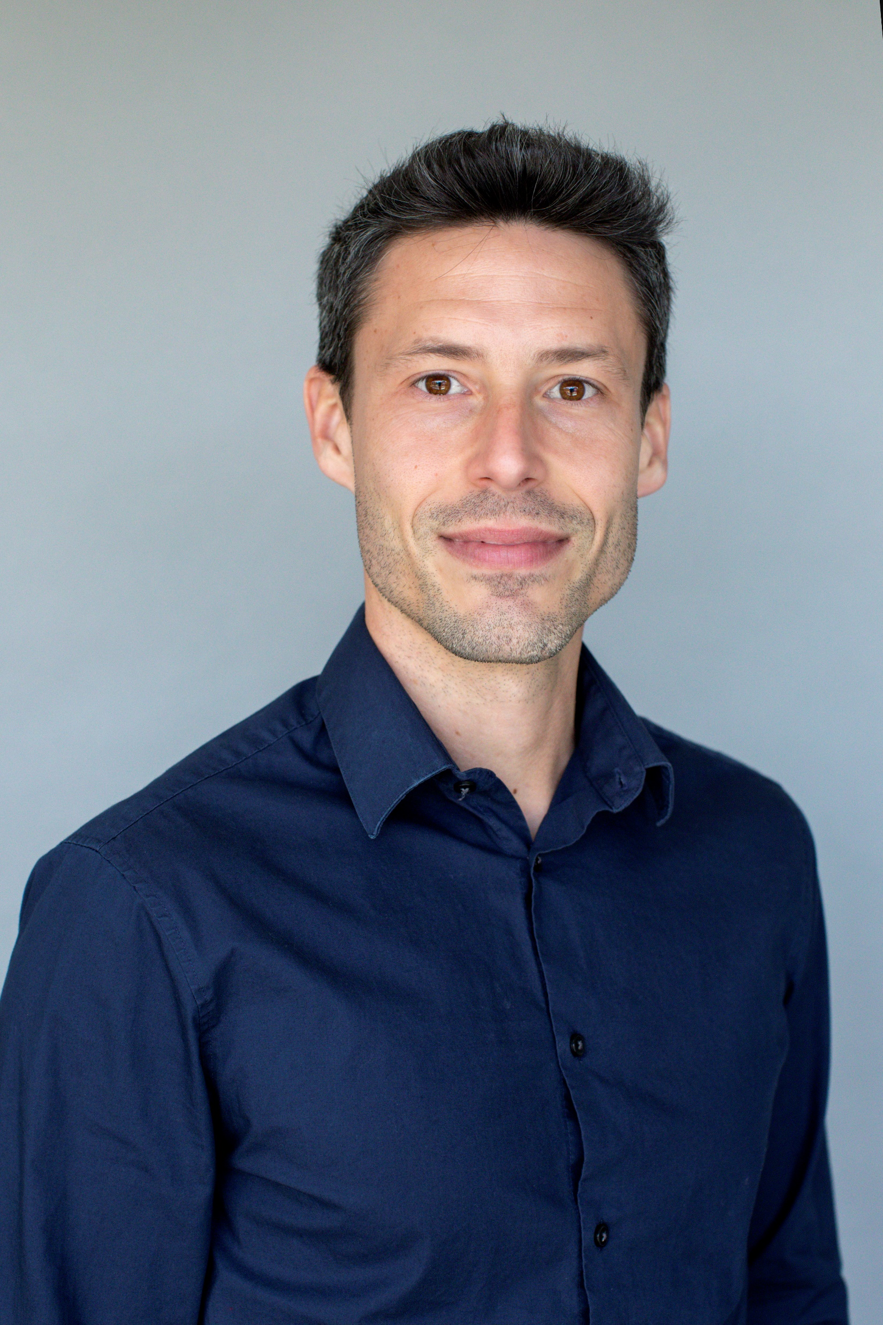
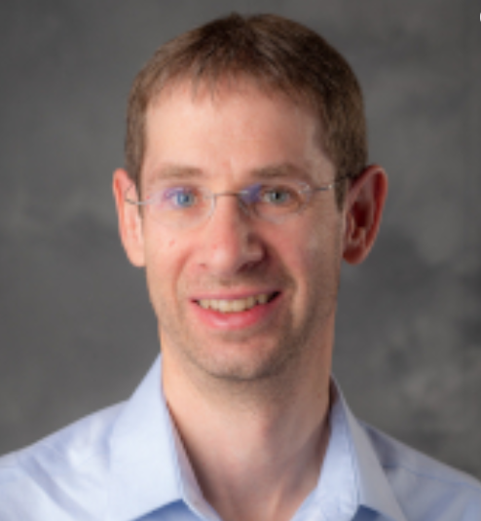
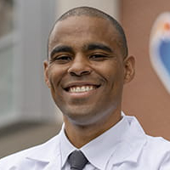
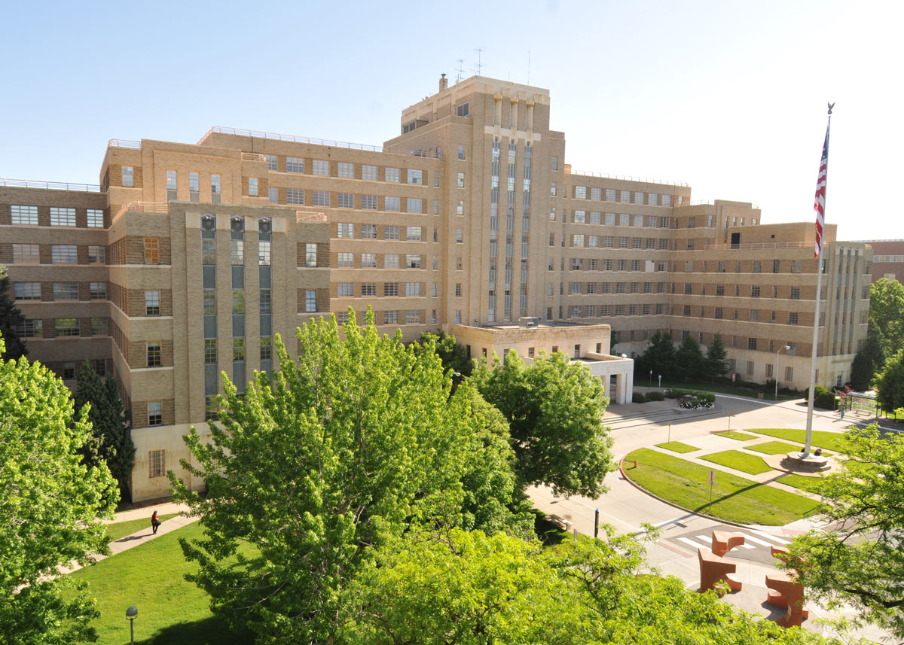


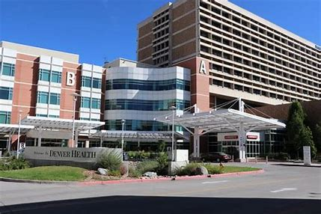

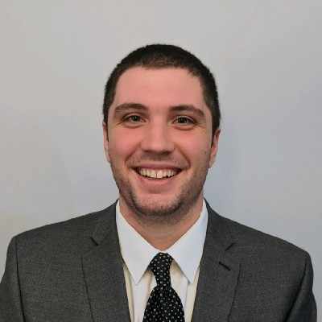
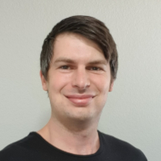


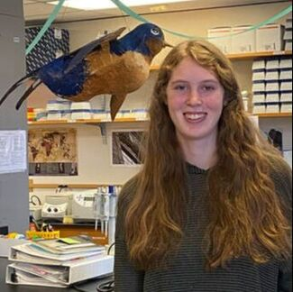
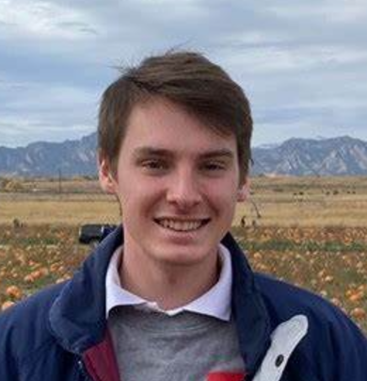
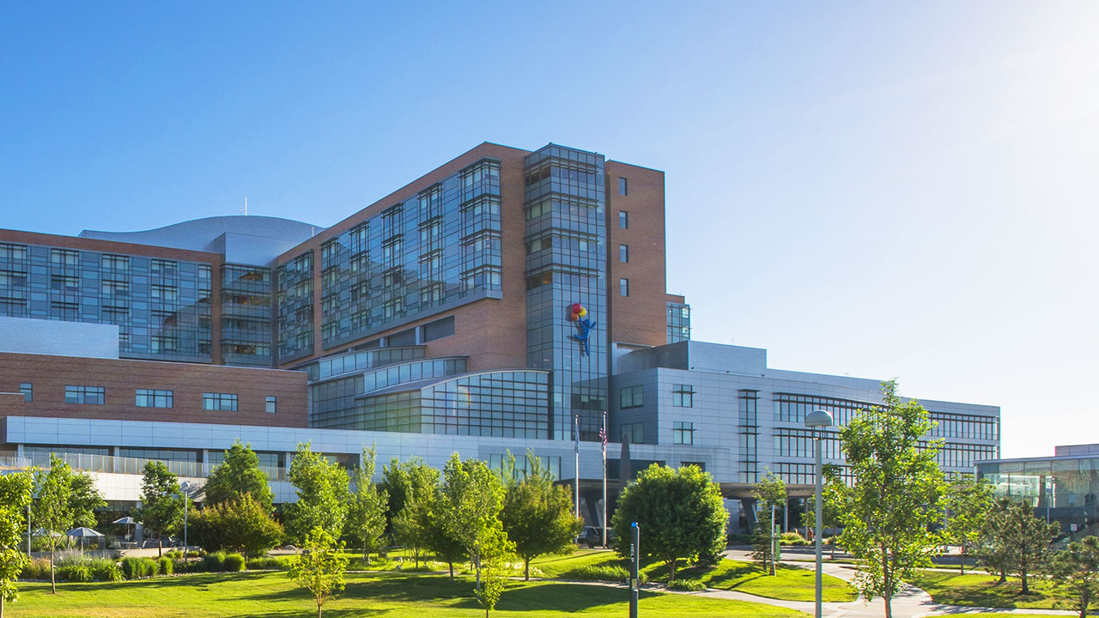
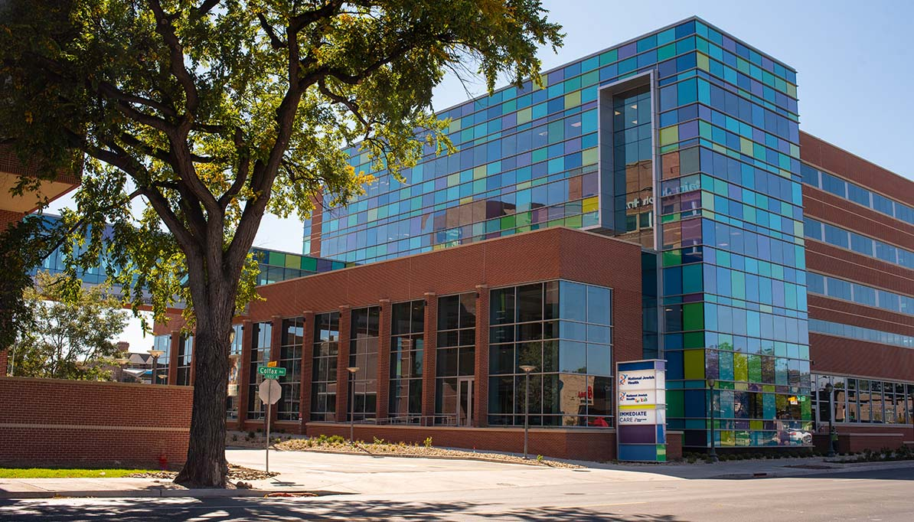


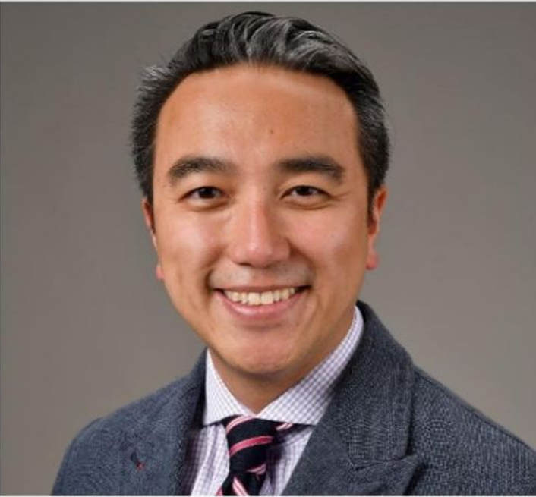
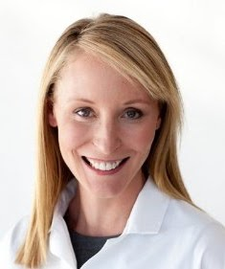
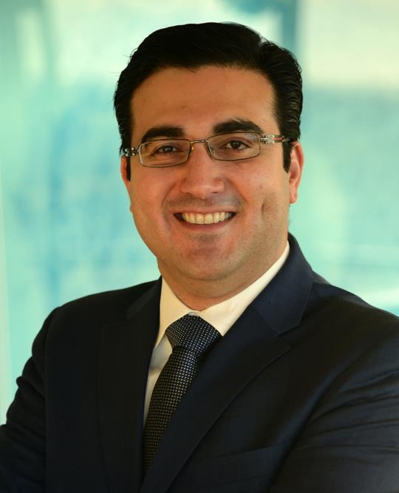
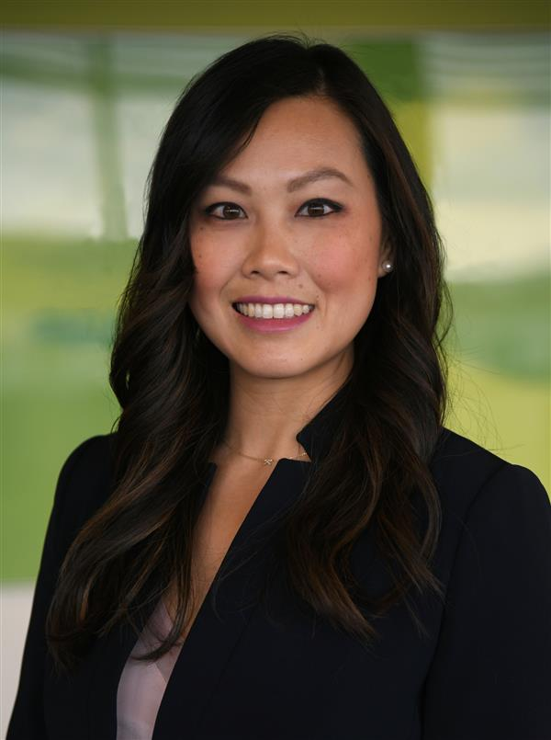
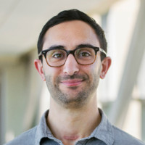
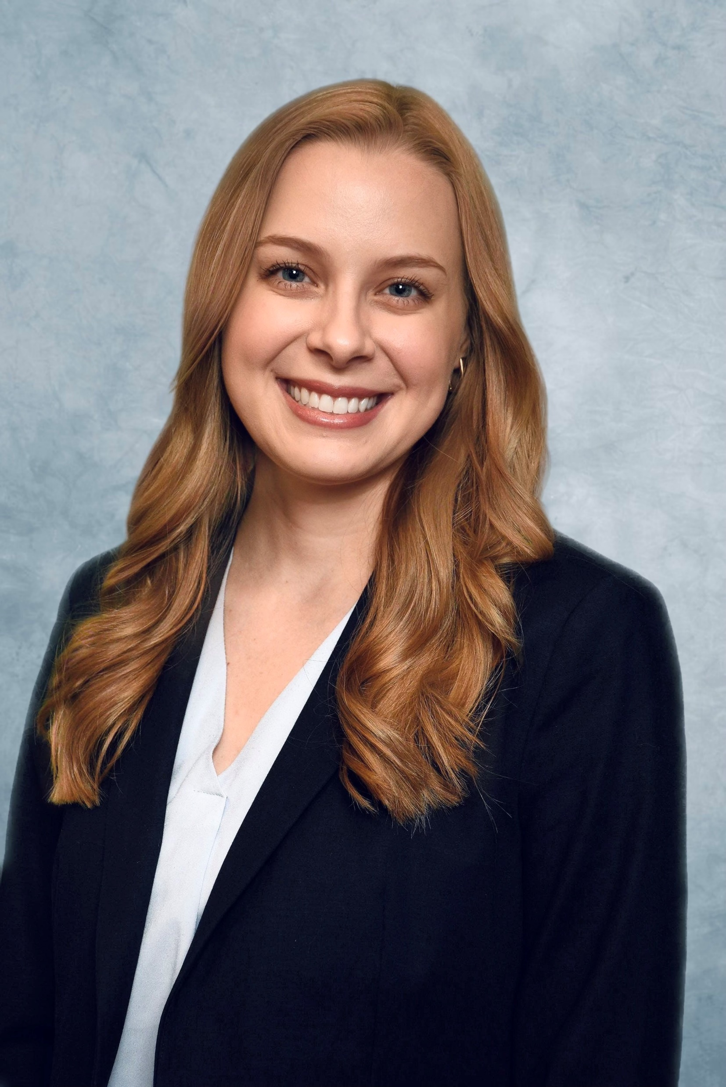
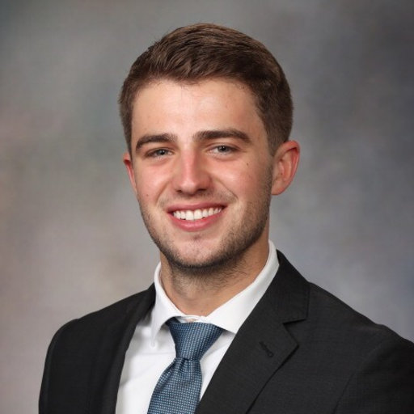
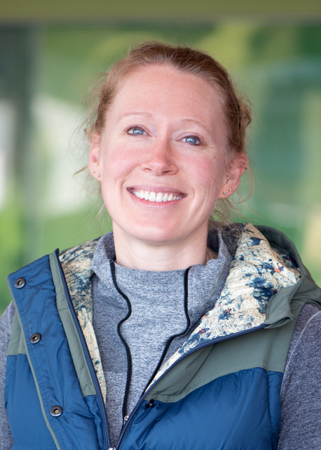
Medical Image Computing & Machine Learning
Human Centered Design & Clinical Translation
Clinical and Radiological Research

Slide 3
My activities within MICCAI
2018 Granada
Associate to General Chairs Executive Committee
MICCAI Mentorship Program
2020 Lima (virtual)
Chair for Young Investigators and Early Career Development Program
NIH awards for underrepresented investigators
2021 Strasbourg (virtual)
2022 Singapore
2023 Vancouver
Continuous MICCAI Mentorship Program
MICCAI Career Advancement Working Group
2024 Marrakesh
Chair for Career Development and Students

Slide 4
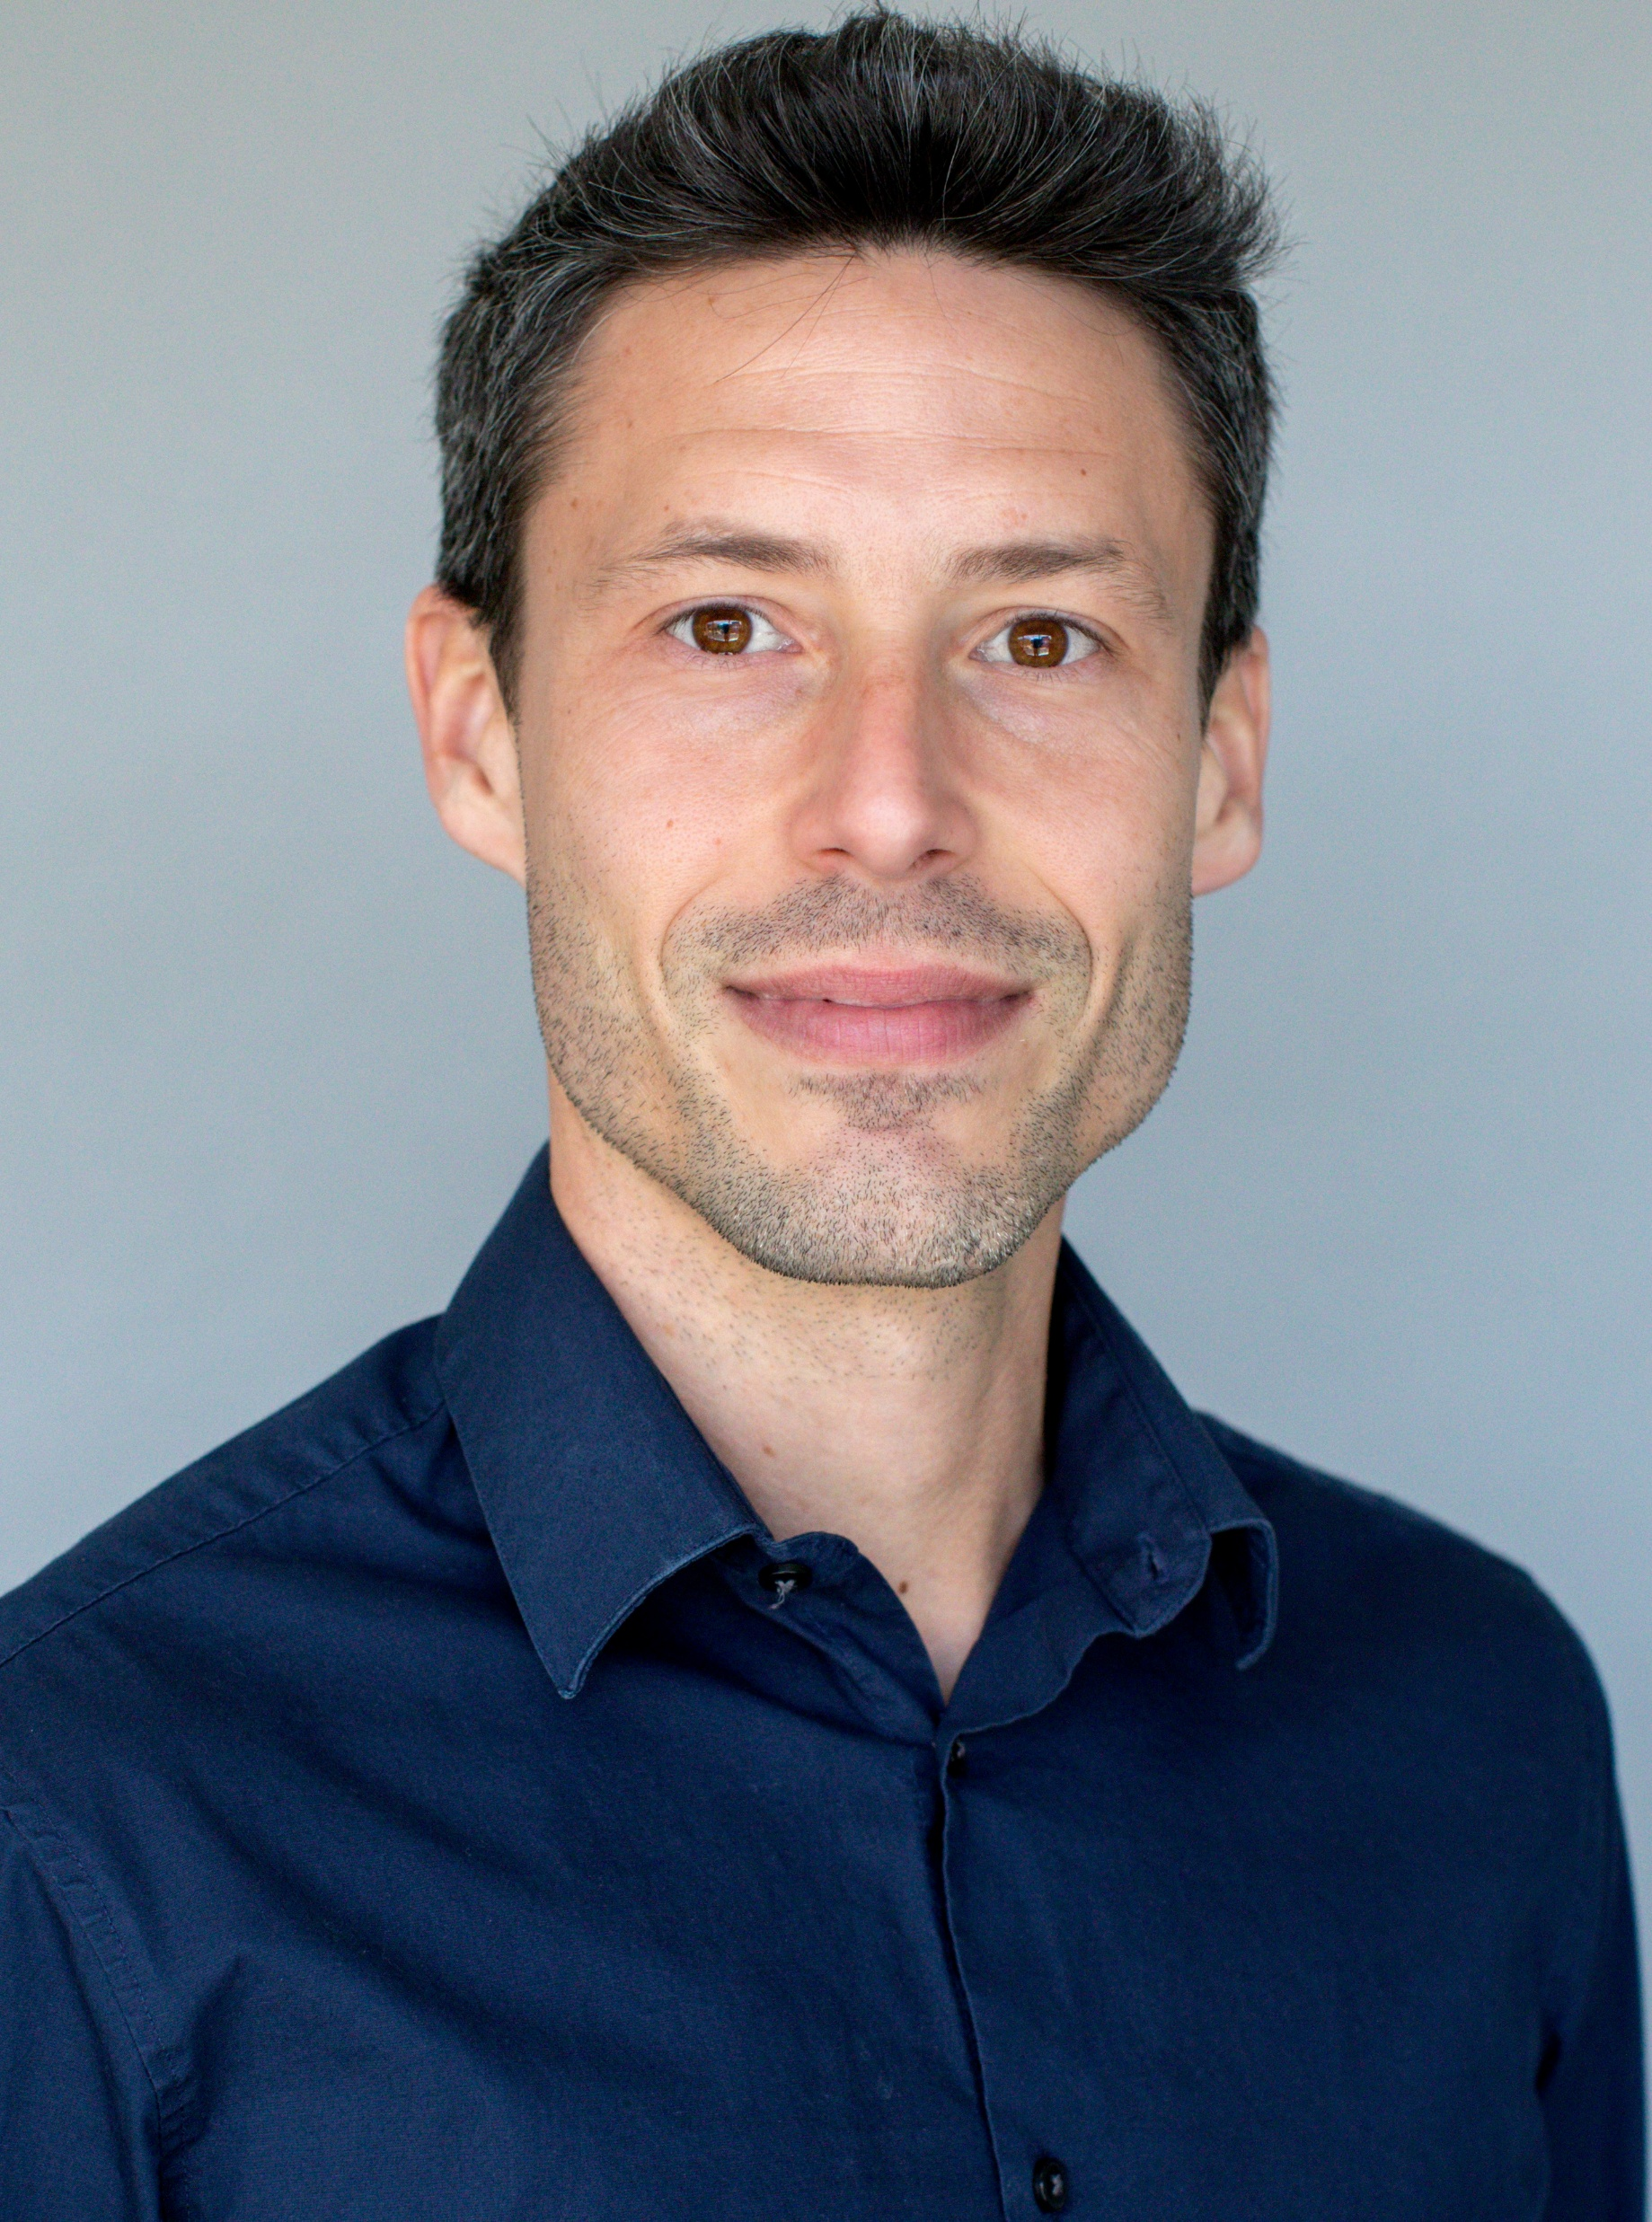
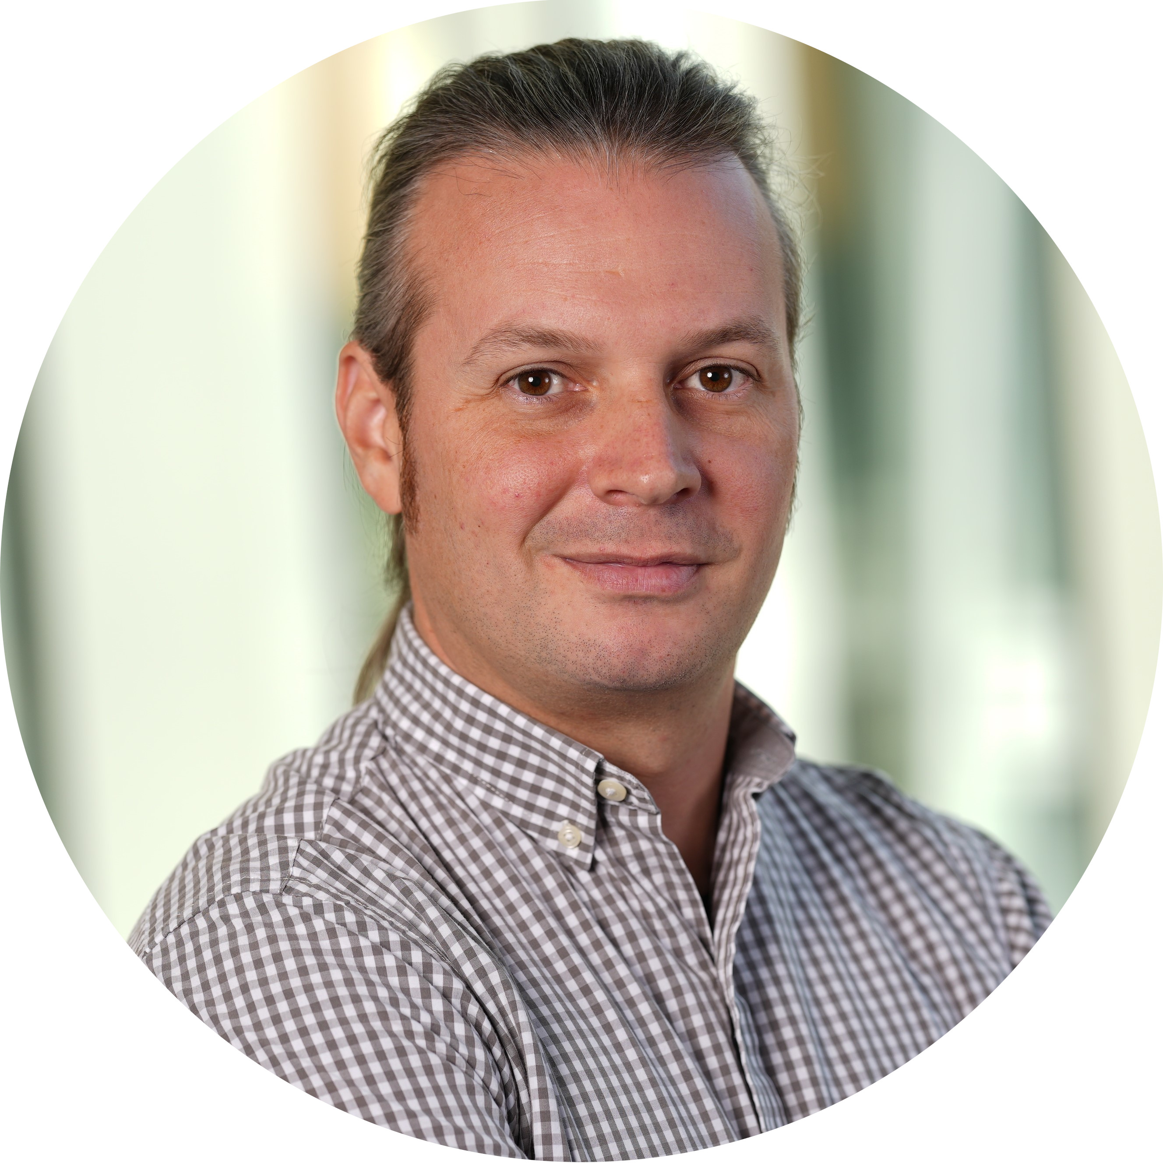
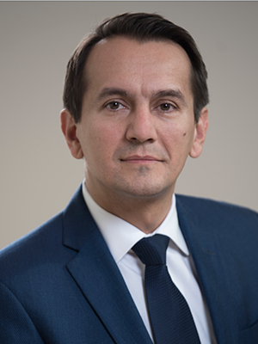
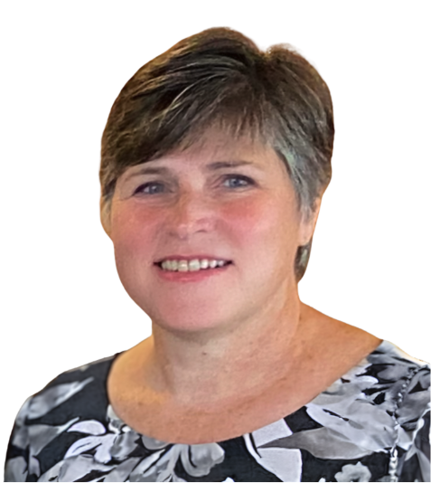
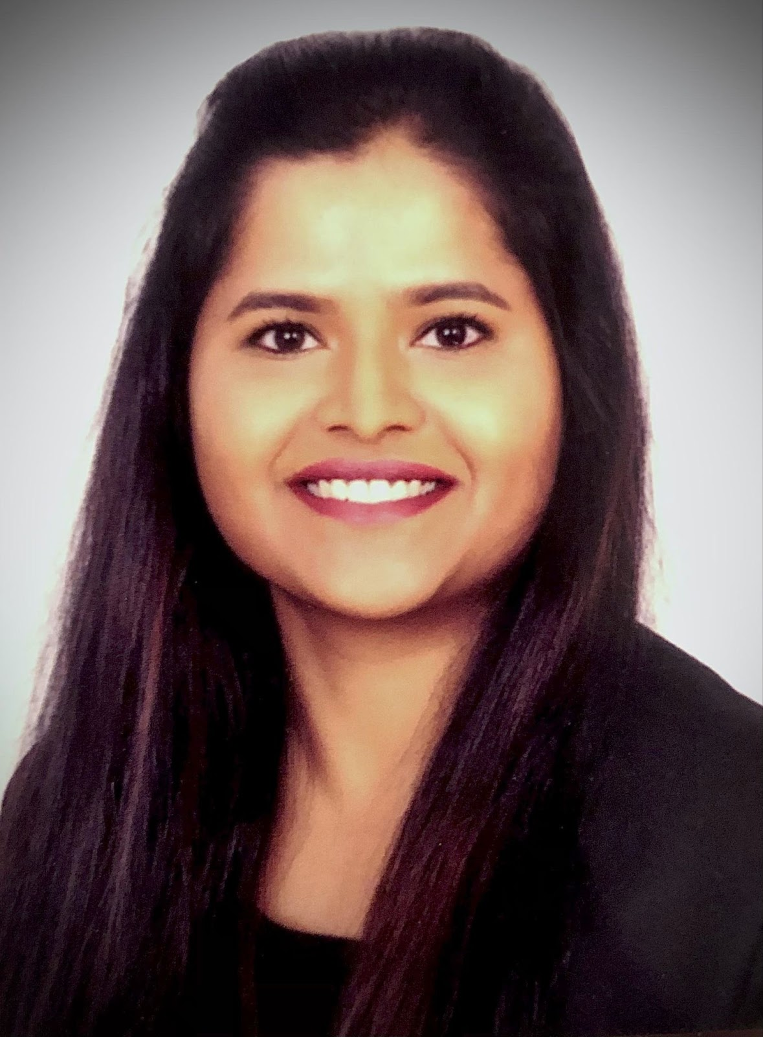
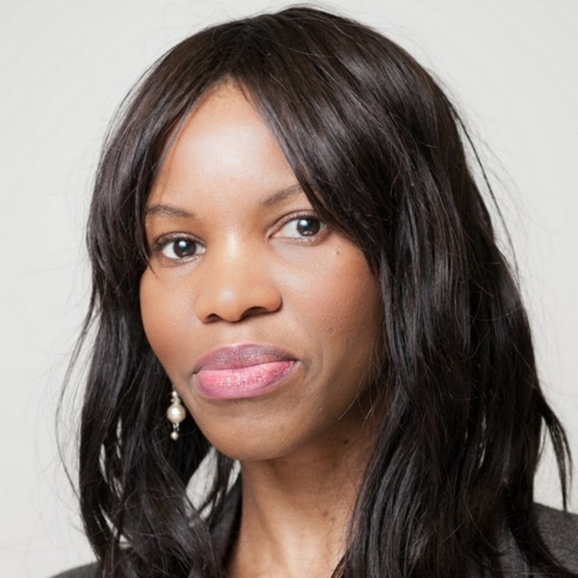
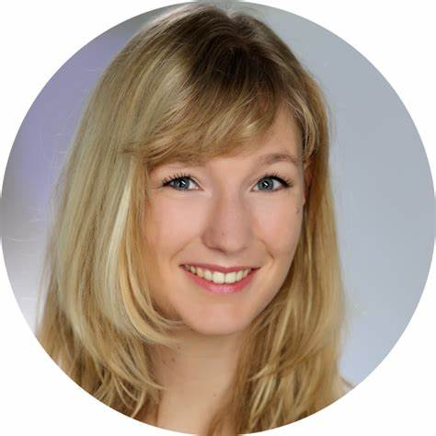

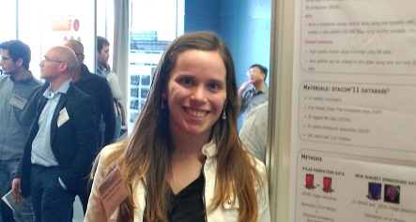
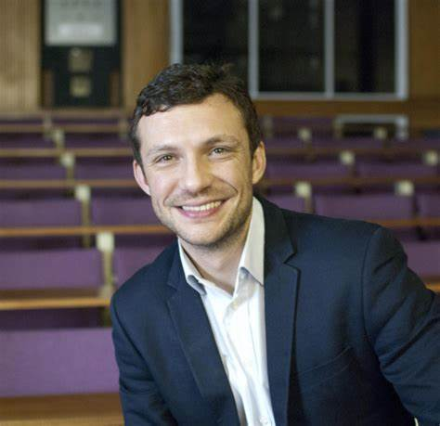
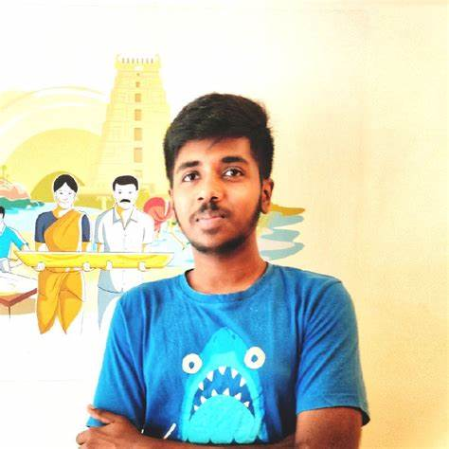
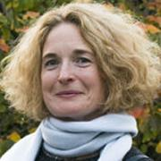
MICCAI Career Advancement Working Group
Antonio R. Porras University of Colorado USA
Spyros Bakas Indiana University
USA
Marius George Linguraru Children’s National Hospital USA
Diana Cuningham MICCAI Society Canada
Anees Kazi Mass. General Hospital USA
Udunna Anazodo McGill University Canada
Nicola Rieke NVIDIA Germany
Bella Specktor Haifa University Israel
Esther Puyol Heartflow & KCL UK
Danail Stoyanov University College London UK
Naren Akash AIG Hospitals India
Kathleen Curran University College Dublin Ireland

Slide 5
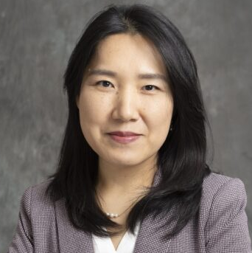
MICCAI Career Advancement Working Group
MICCAI conference career advancement initiatives
MICCAI 2025
MICCAI 2026
Liaisons with other MICCAI working groups
MSB
WiM
RISE
Education
MICCAI Society Mentorship Program
Young Scholars Program (2025)
RISE-MICCAI Mentorship (2026)
MICCAI Startup Village
MICCAI Mentorship Programs

Slide 6
MICCAI Mentorship Programs
MICCAI Society Mentorship Program
RISE-MICCAI Mentorship Program
What
Career-focused program. Duration: 6 months – 2 years.
Focus on first MICCAI paper submission. Duration: 1 year
Who
Mentees: Students, postdoctoral fellows and early career investigators who are members of the MICCAI Society (exceptions for LMIC).
Mentors: Experienced academic or private sector investigators in the MICCAI Society.
Mentees: Students after participating in the RISE-MICCAI Summer School, with priority to underrepresented groups.
Mentors: Experienced academic or private sector investigators in the MICCAI Community.
When
Application is continuous. Matching is performed several times a year.
From September 2025
to September 2026
How
Fill expression of interest form
Apply at the Summer School!

Slide 7


RISE-MICCAI Mentorship Program
You have never attended MICCAI
You want to submit your first MICCAI paper
You have permission from your home supervisor to work with other mentors
You don’t need a project, but you can have one already!
Obtain institutional letter of support from your home supervisor
Apply to the program
Warm up – Work on a previous challenge
Be mentored towards your first MICCAI submission

Slide 8
Why joining the MICCAI community?
Join a global community of innovators
MICCAI brings together top researchers, clinicians, and industry leaders from around the world. As a young investigator, you’ll be immersed in a vibrant, international community that’s shaping the future of medical imaging and AI in healthcare
Learn about and from cutting-edge research
Deep learning, image computing, surgical navigation, computer vision-guided robotics, computational anatomy, artificial intelligence for diagnosis and treatment planning…
Build and expand your network
Find research collaborations, find academic and industrial internship or job opportunities, develop professional relationships, and make friends!
Get inspired
Listen to new ideas, get inspired by fresh perspectives, find what you are passionate about

Slide 9
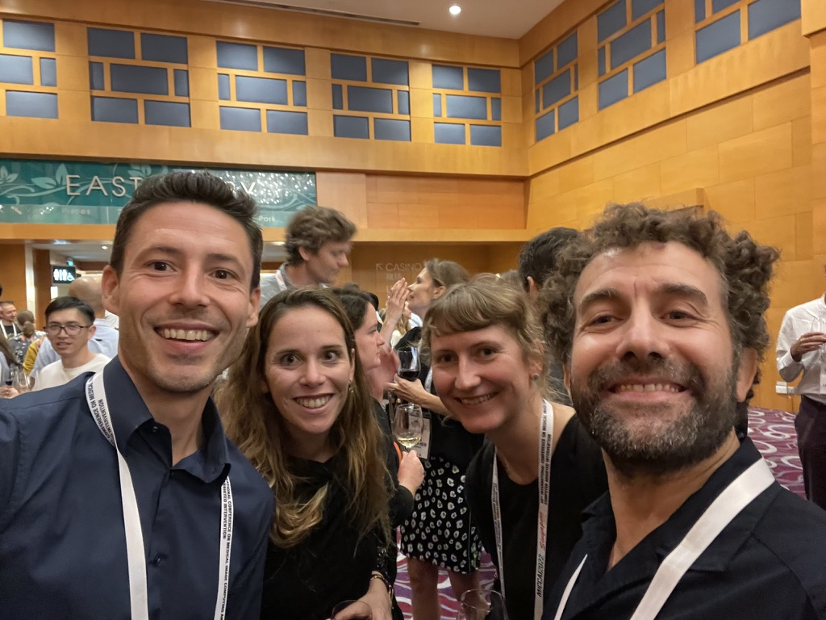
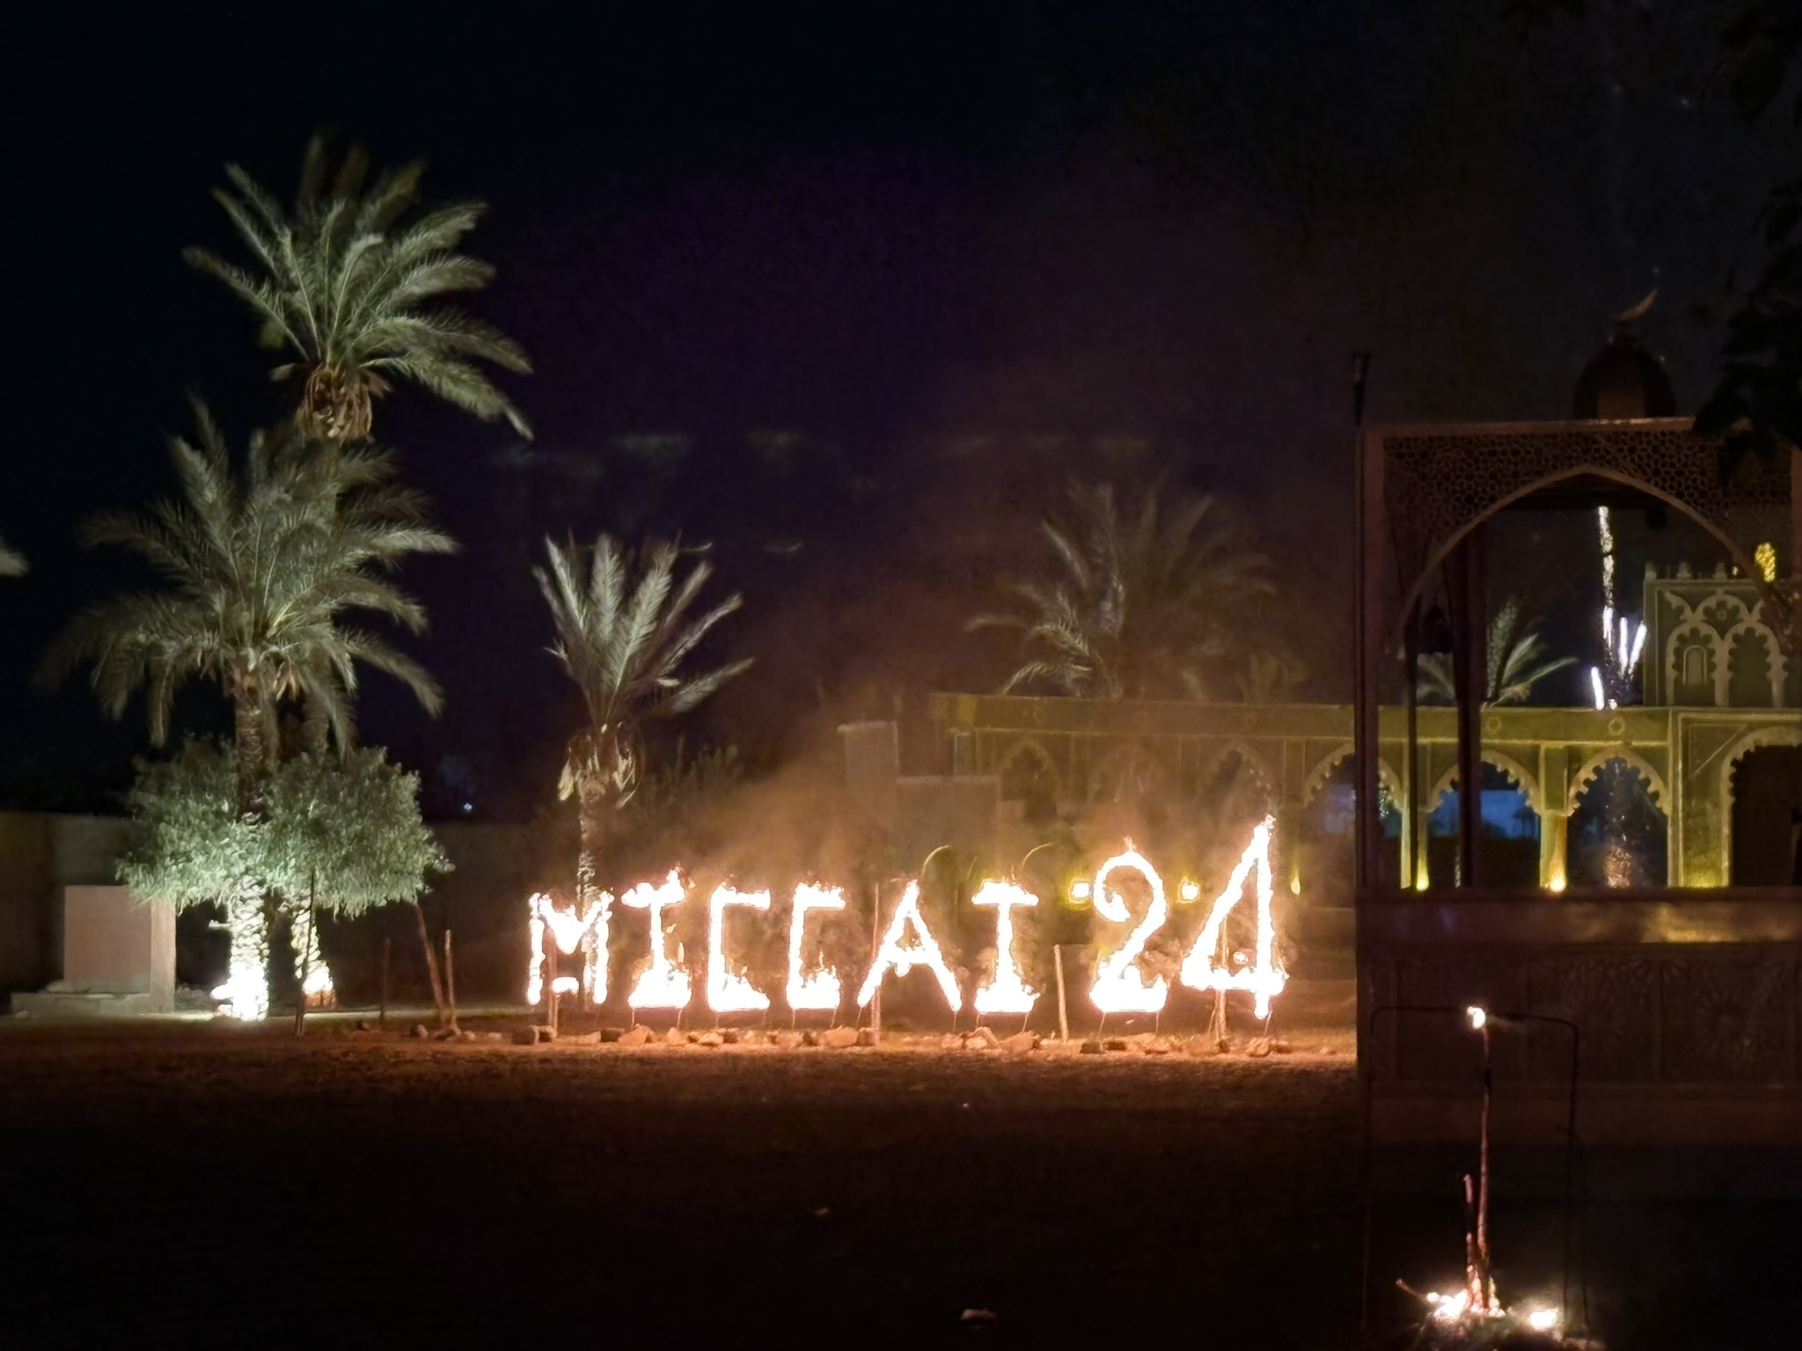
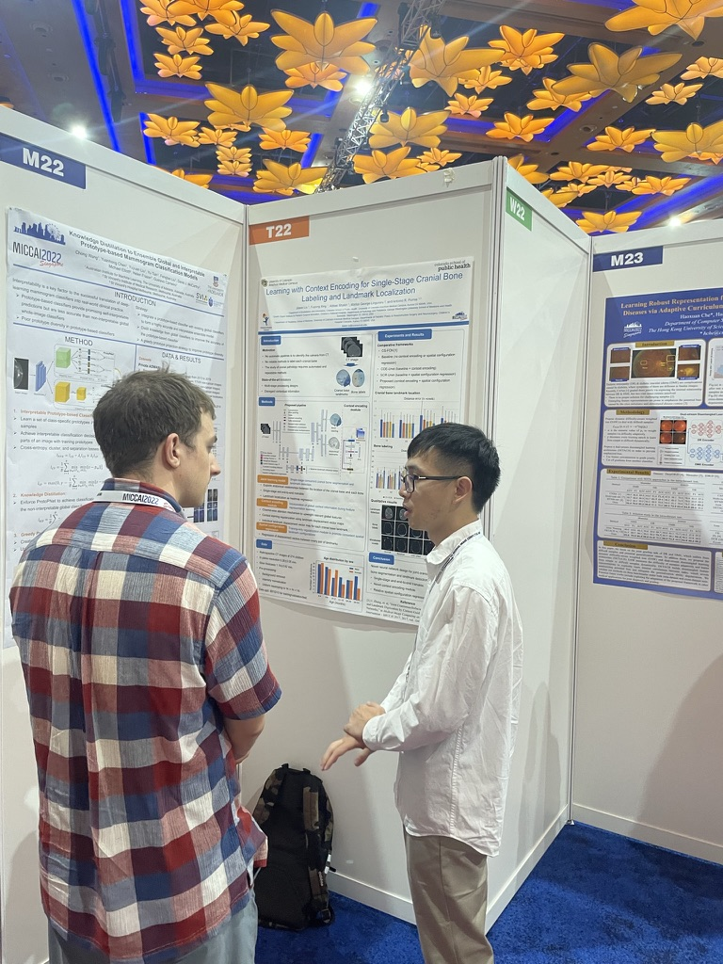
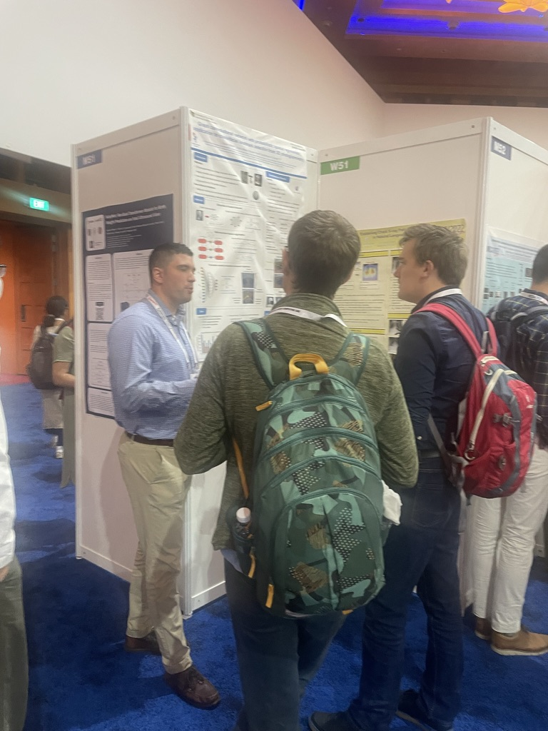
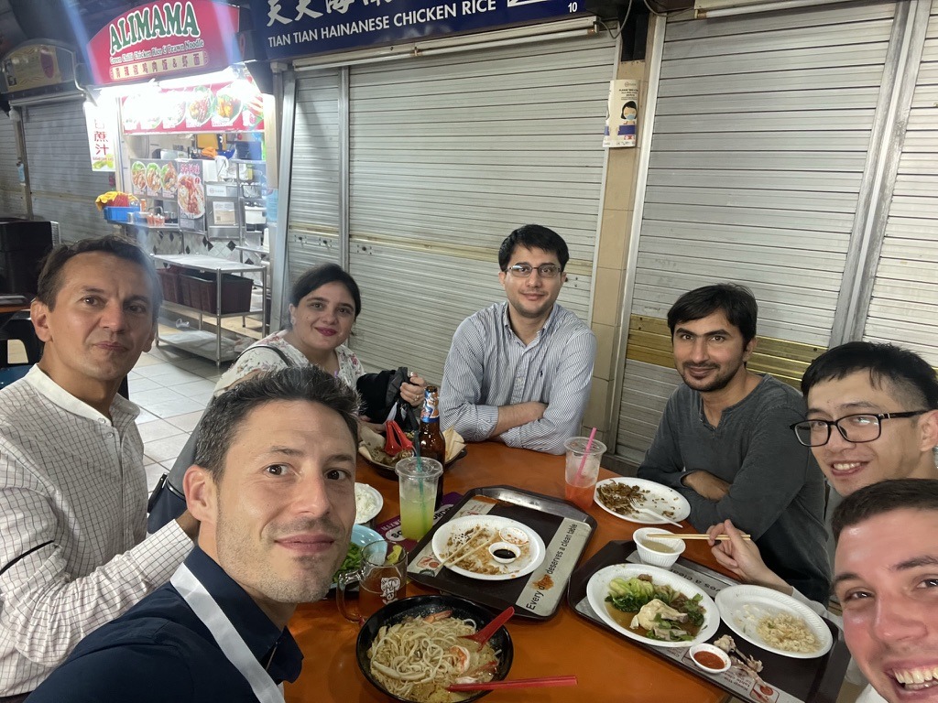
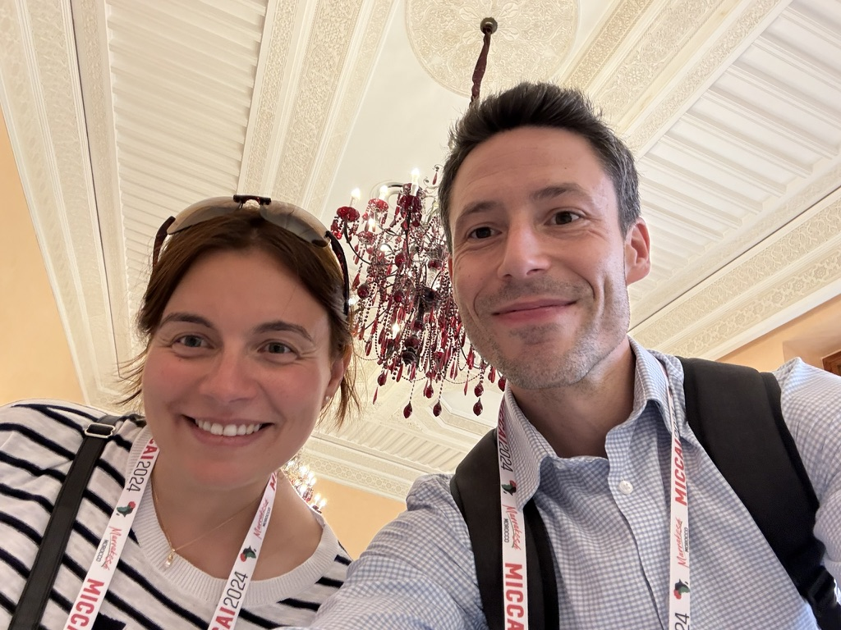
Why joining the MICCAI community?
… but is also fun!

Slide 10

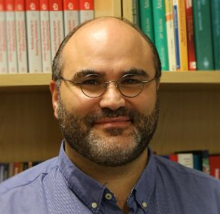
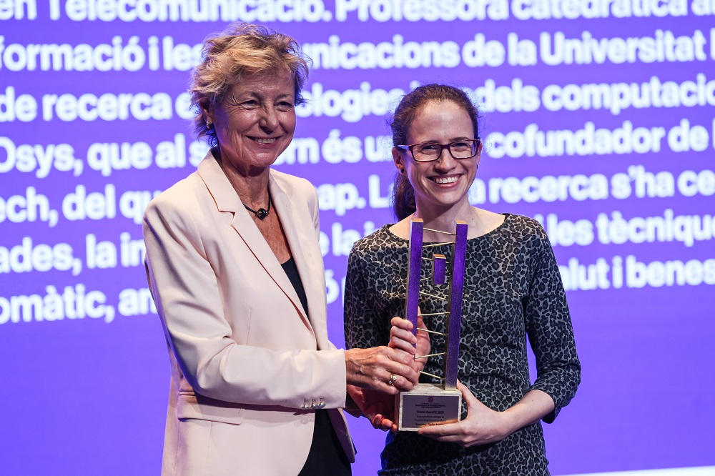




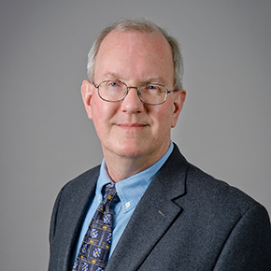
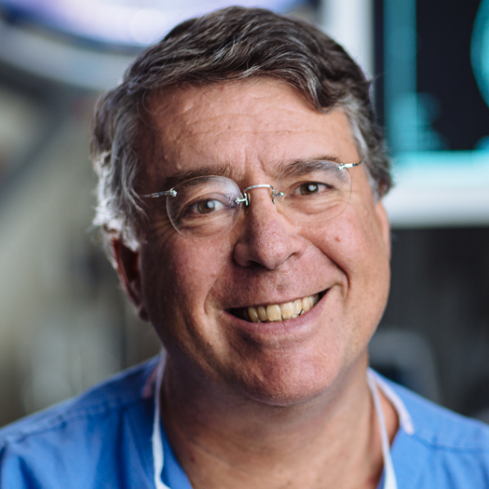
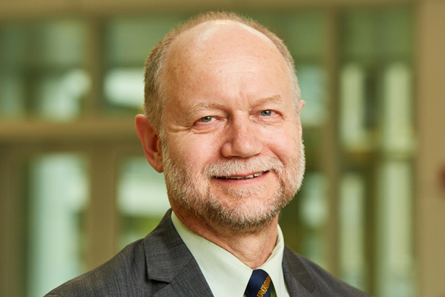
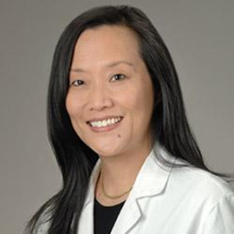
My story as a mentee
Workshop presentation
Main conference + Travel award
Workshop award
Main conference + Nomination to Young Investigator Award
Main conference
Associate to General Chairs
Won an NVIDIA GPU!
I was mentored in the first MICCAI mentorship program!
And I learned from others too…

Slide 11
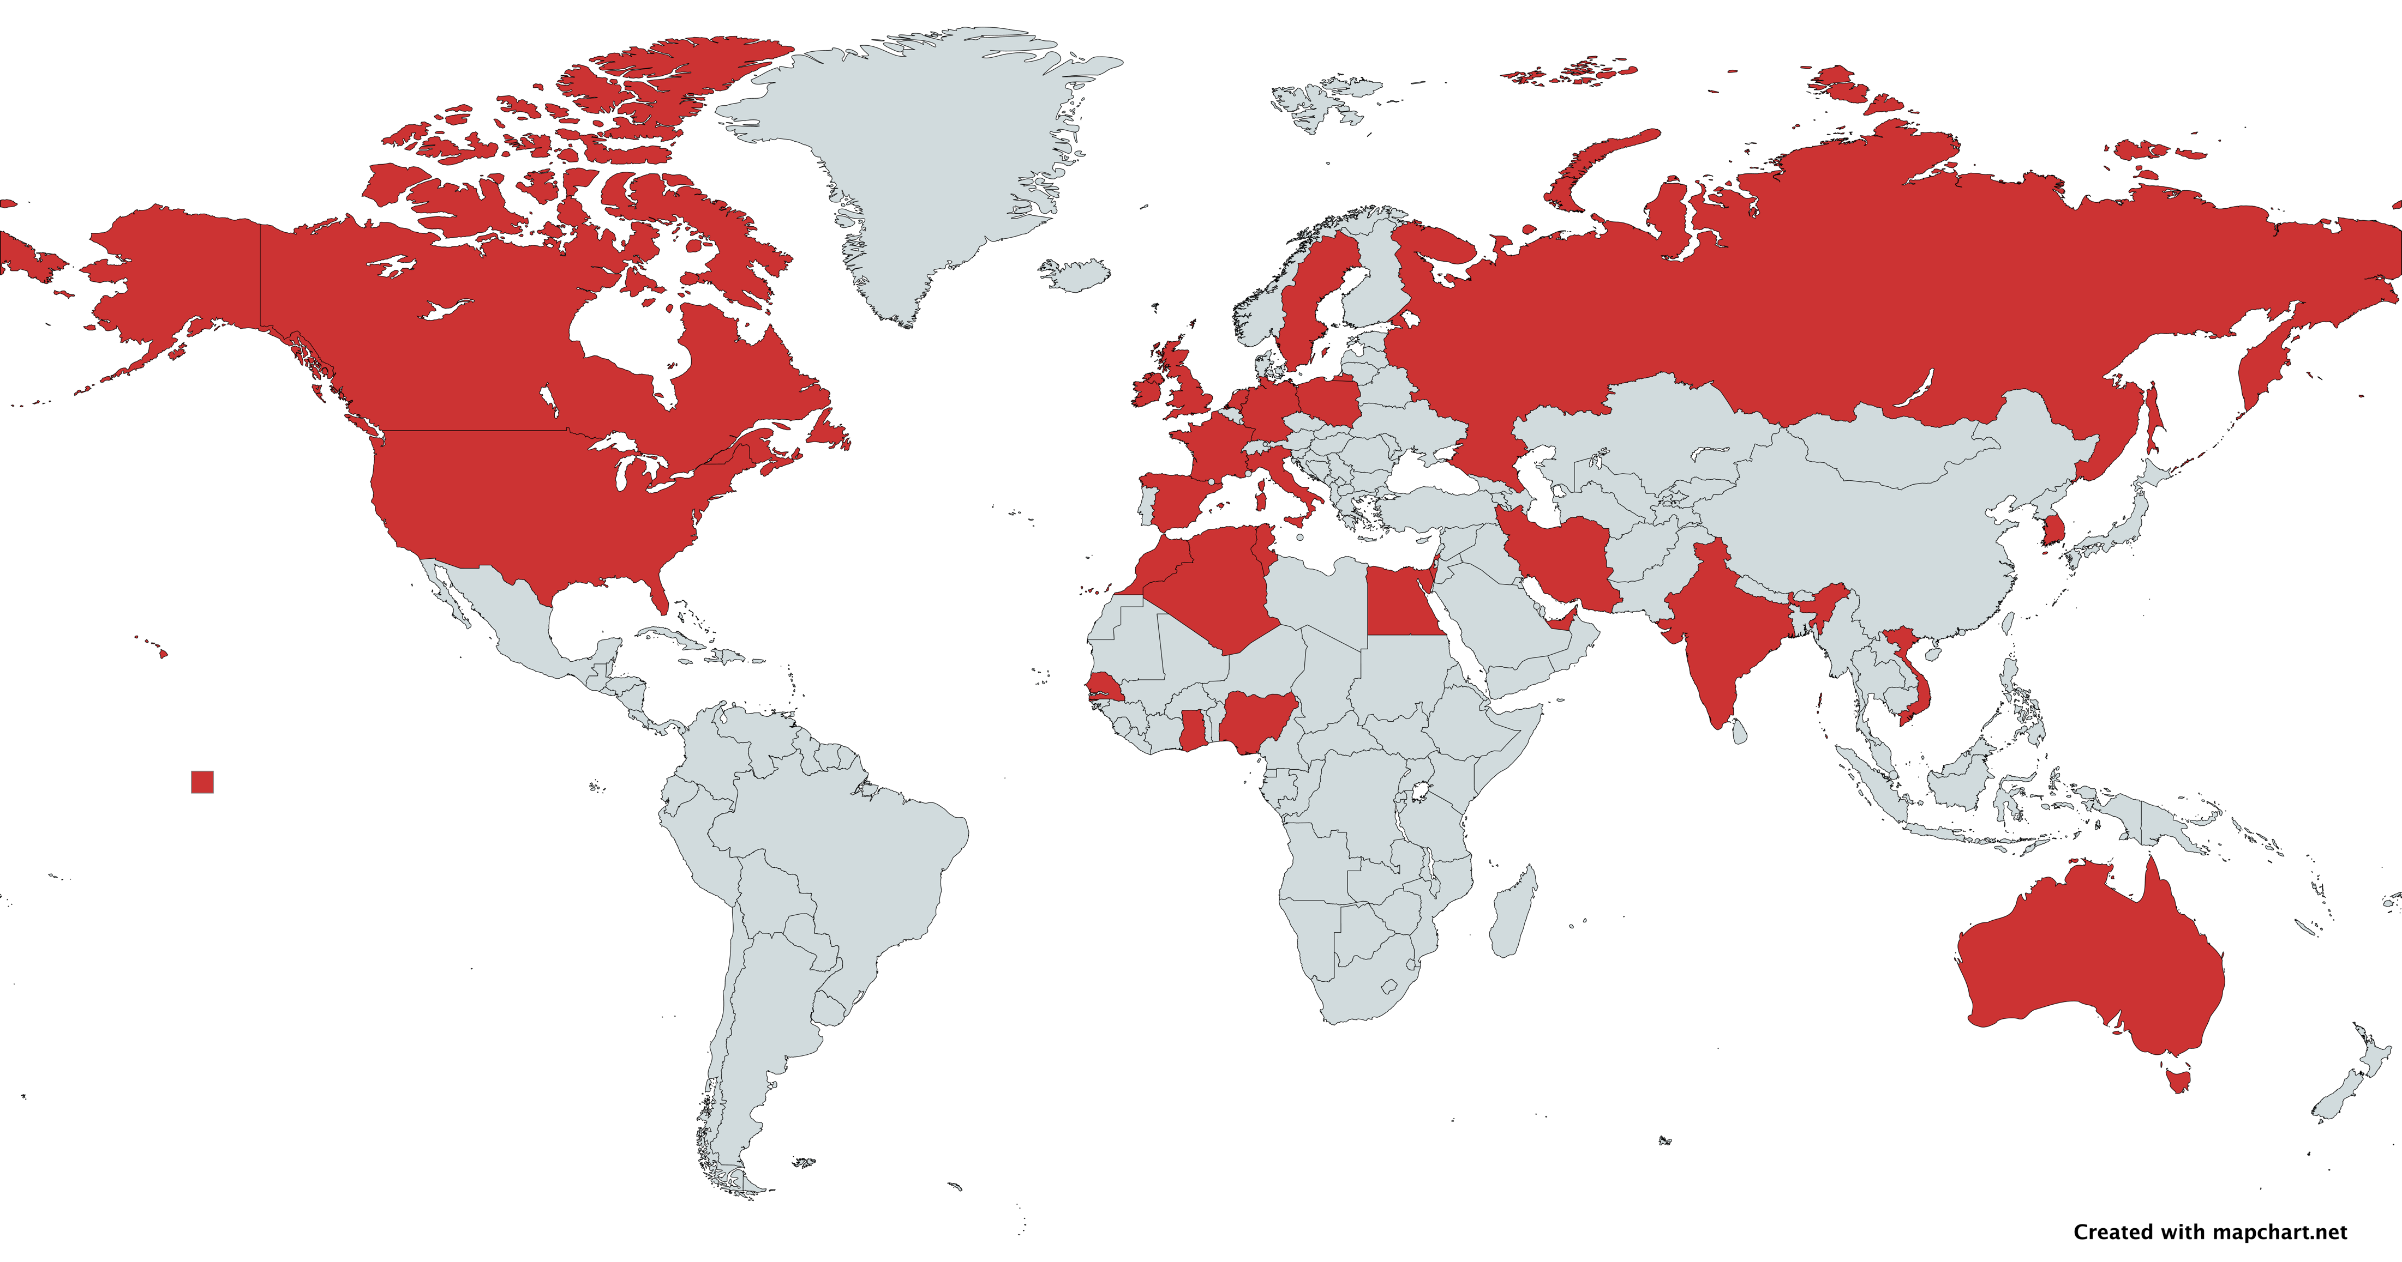
MICCAI Mentees

Slide 12
What to expect from RISE-MICCAI mentoring?
Get connected: You will be matched with a successful expert mentor from the MICCAI community
Define your project: What is the problem? Why is it significant? What are the challenges? How do you plan addressing the problem?
Establish expectations: How and how often are you going to communicate with your mentor? What are the milestones and their timeline?
Lead the relationship: Set meeting agendas, send calendar invites, reach out and speak up when you need help from your mentors
Work hard and smart: Do your best to meet expectations and be transparent about unexpected challenges
Be respectful: A mentorship relationship is a two-way road
Consider satellite events: the main MICCAI conference is only the beginning

Slide 13
Timeline
Work on your challenge
Main conference deadline
Mentorship ends?
July-August 2025
~March, 2026
October 1, 2026
MICCAI!
July 14-18, 2025
September 1, 2025
~June, 2026
Summer School
Mentorship kickoff
Satellite event deadline
Join the MICCAI Society Mentorship Program after MICCAI and maximize your potential

